Slide 1
Statistical Reasoning
UNIT 4

Slide 2
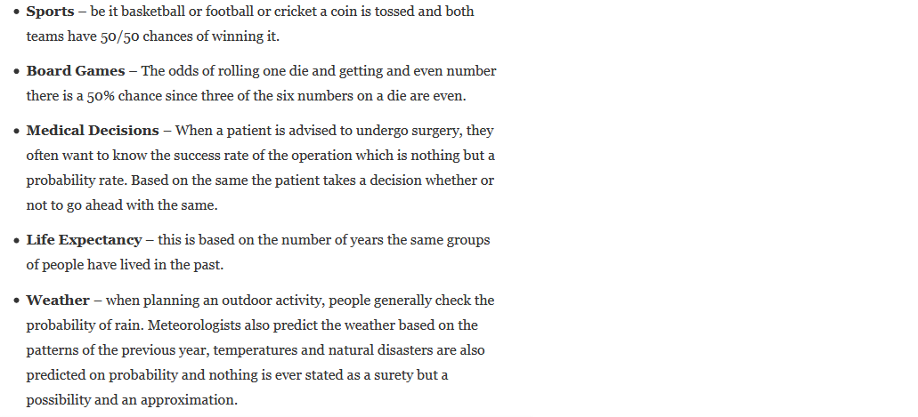
Few Real life Examples
Card Games: Traditional card game of skills ‘rummy’ uses the concept of probability, along with those of permutations and combinations. Players keep on calculating their chances of getting a particular card they require and in the process learn these concepts without making conscious efforts.
Video Games and Board Games: On the same lines, these games too propel the player to think in terms of probability.
EARTHQUAKE RISK
Train/Bus Seat Confirmation
Dictionary
Flight scheduling
Stock Market Prediction
Speech recognition

Slide 3
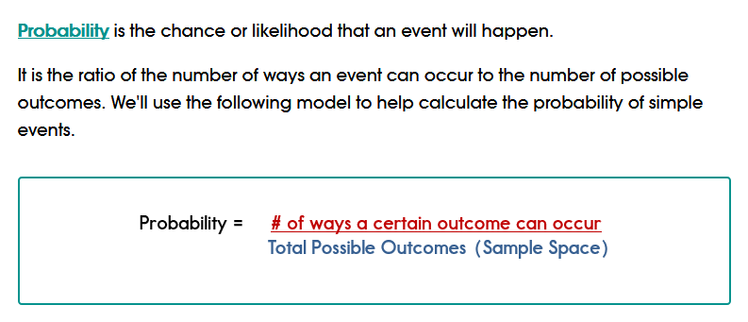
Probability

Slide 4
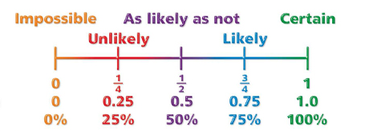
Probability quantifies as a number between 0 and 1, where, loosely speaking, 0 indicates impossibility and 1 indicates certainty.

Slide 5
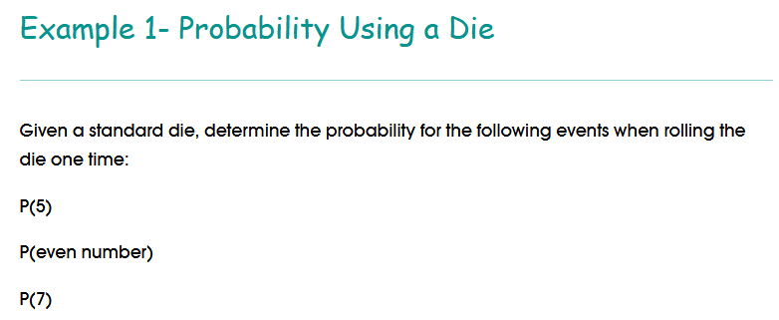
Some Probability Examples:

Slide 6
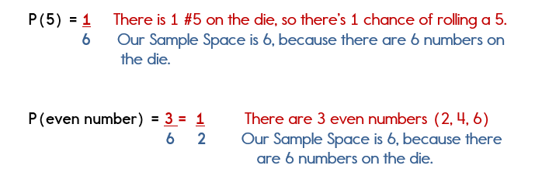
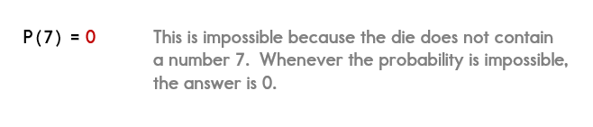

Slide 7
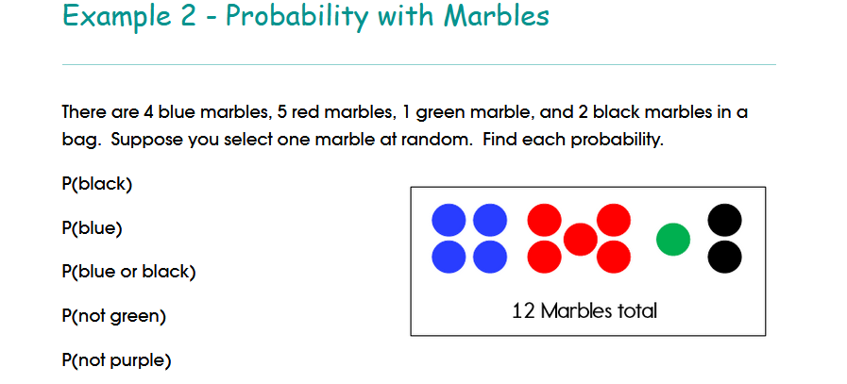

Slide 8
Event
An event is a set of outcomes of an experiment .
Examples
"A King" (4 elements),
"A Face card" (12 elements),
"A Spade" (13 elements),
"A Face card or a red suit" (32 elements),
"A card" (52 elements).

Slide 9
Deterministic Event Vs Random Event
Deterministic Event
An Experiment whose outcome or result can be predicted with certainty is called a deterministic Event.
Example: V=IR
Random Event
An Experiment whose outcome or result cannot be predicted with certainty is called a Random Event.
Example :Rolling a Dice

Slide 10
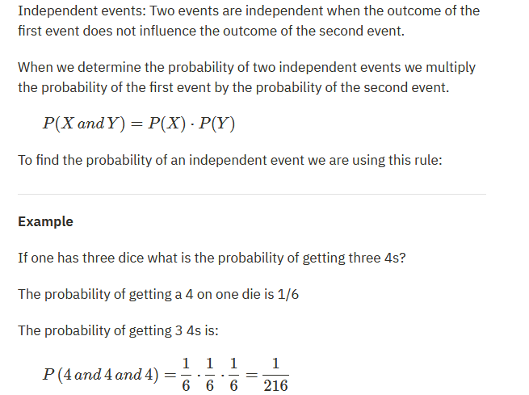
Independent Events

Slide 11
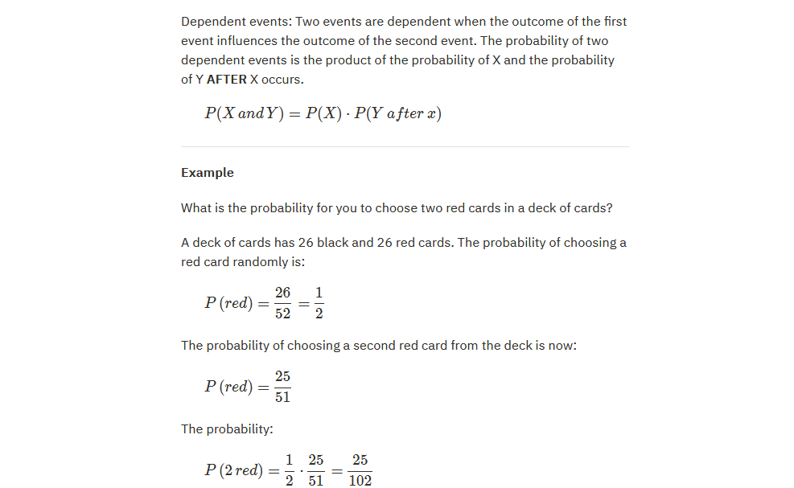
Dependent Events:

Slide 12
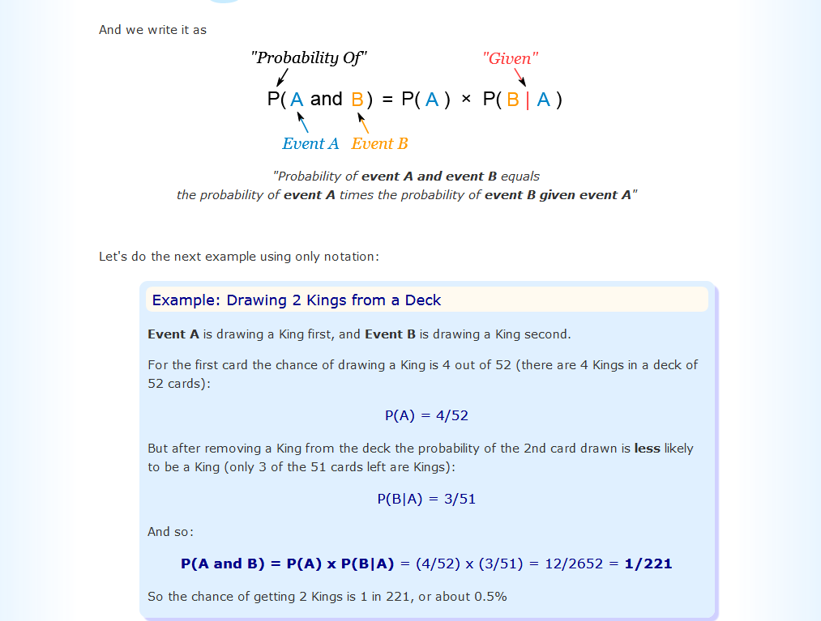

Slide 13
Bayes’ theorem
Bayes’ theorem, named after 18th-century British mathematician Thomas Bayes, is a mathematical formula for determining conditional probabilities. This theorem has enormous importance in the field of data science.
Bayesian inference is a method in which Bayes’ theorem is used to update the probability for a hypothesis as more evidence or information becomes available. Bayesian inference has found application in a wide range of activities, including science, engineering, philosophy, medicine, sport, and law.
In finance, for example, Bayes’ theorem can be used to rate the risk of lending money to potential borrowers.
In medicine, the theorem can be used to determine the accuracy of medical test results by taking into consideration how likely any given person is to have a disease and the general accuracy of the test.

Slide 14
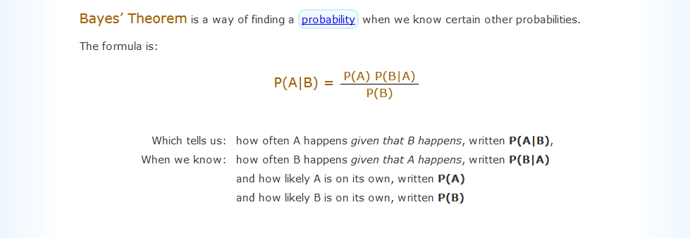

Slide 15
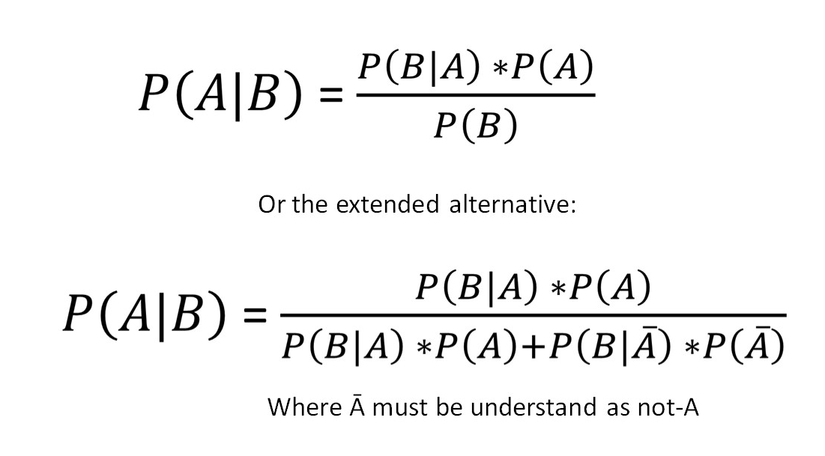

Slide 16
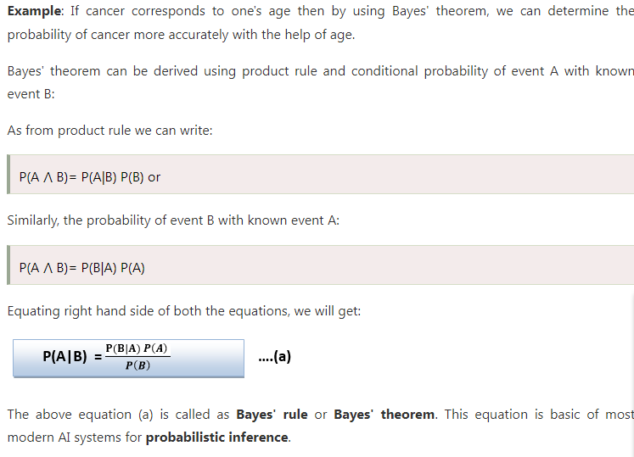

Slide 17
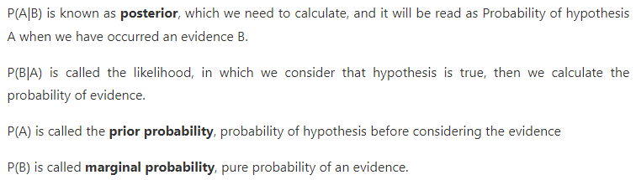

Slide 18
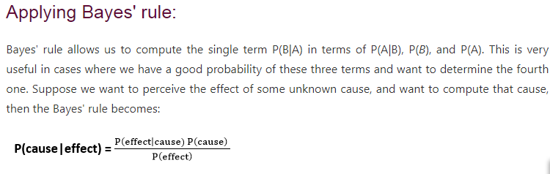

Slide 19
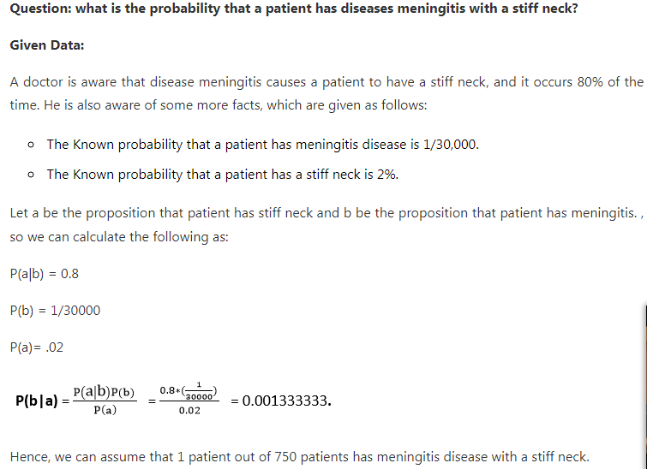

Slide 20
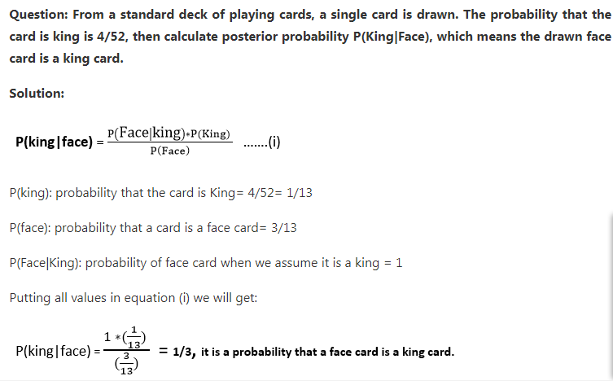

Slide 21
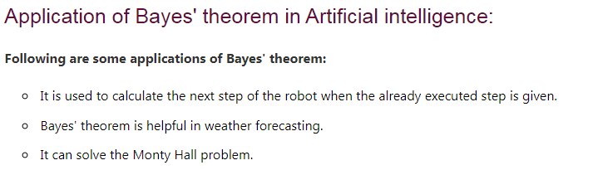

Slide 22
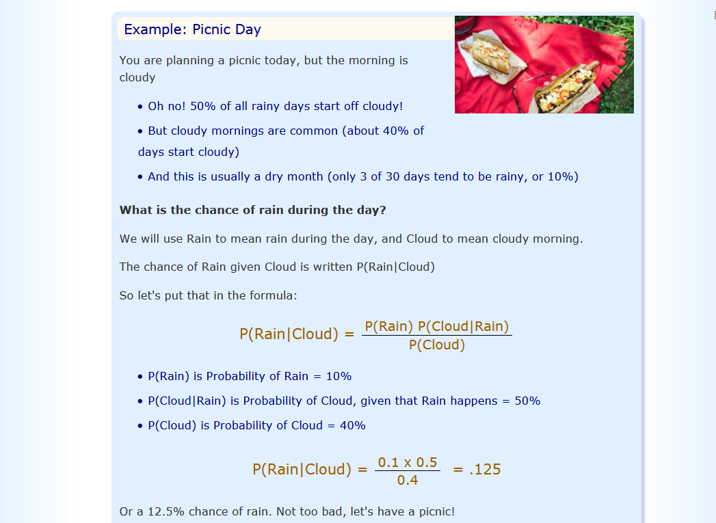

Slide 23
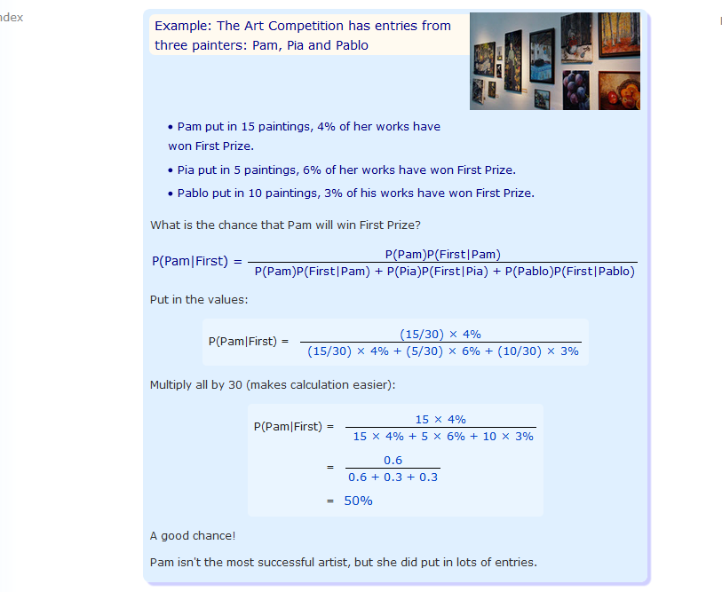

Slide 24
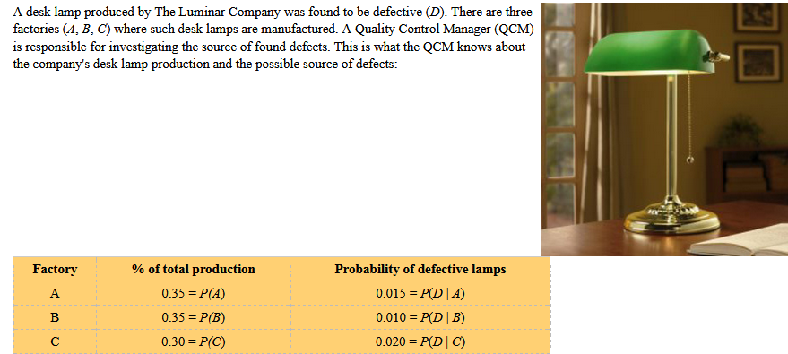

Slide 25
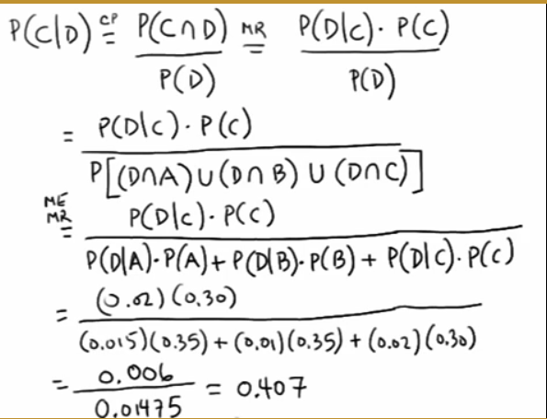

Slide 26
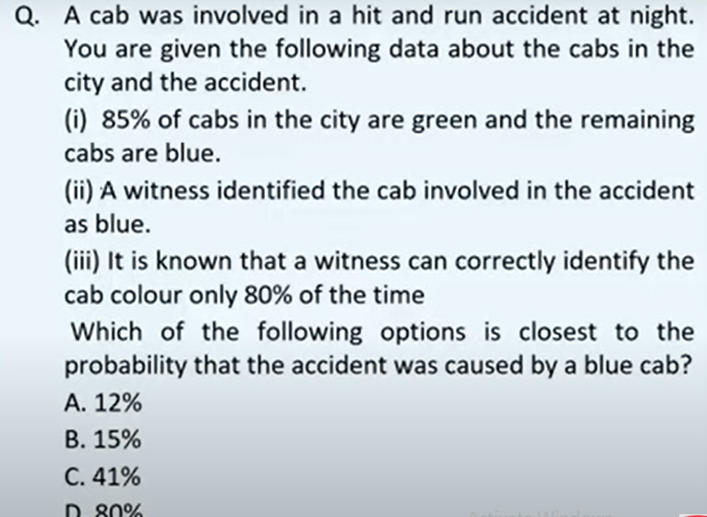
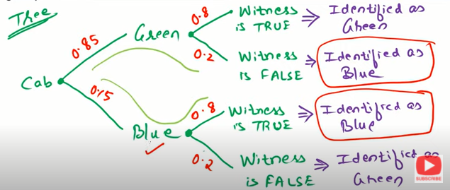

Slide 27
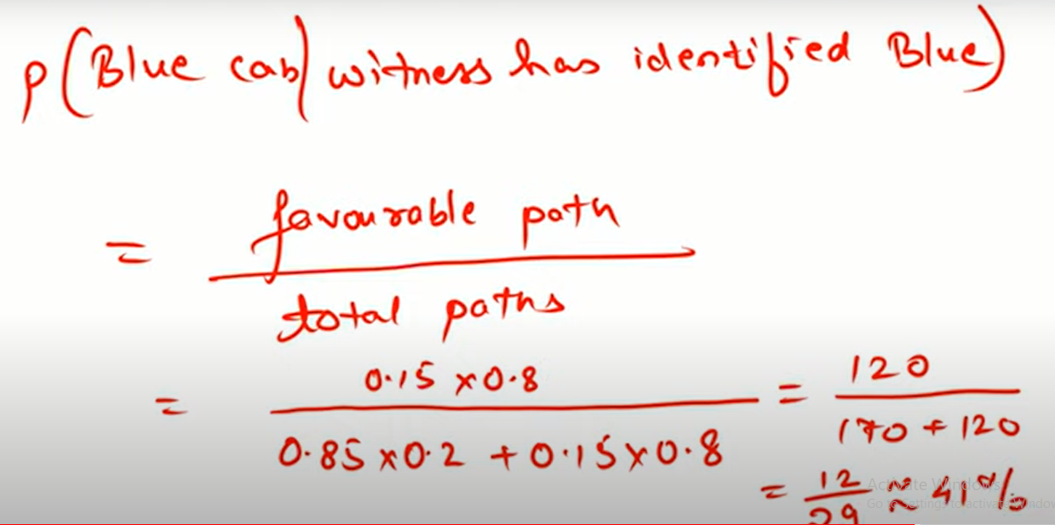

Slide 28
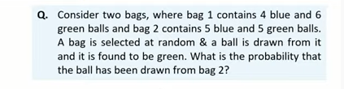
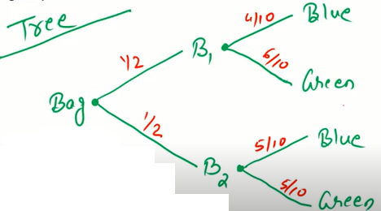

Slide 29
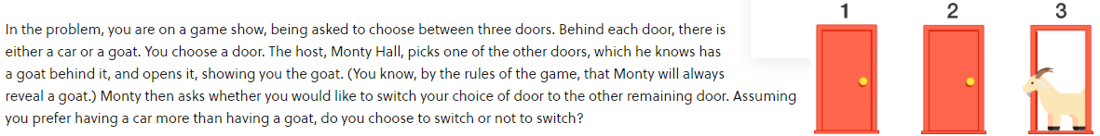

Slide 31
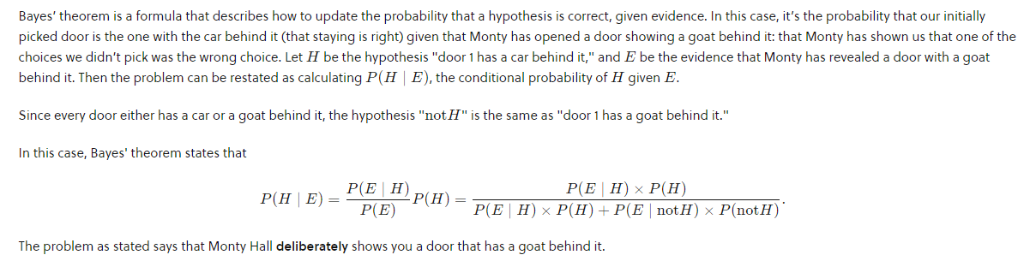

Slide 32
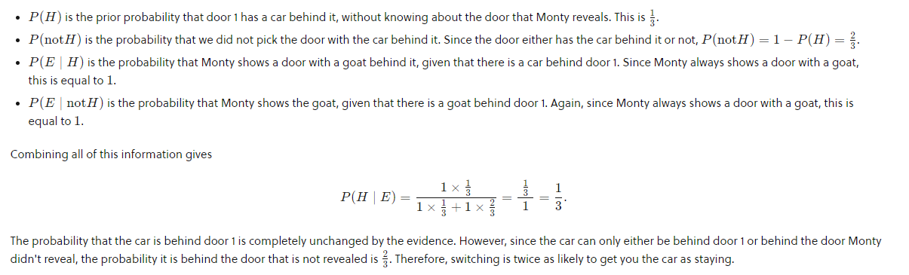

Slide 33
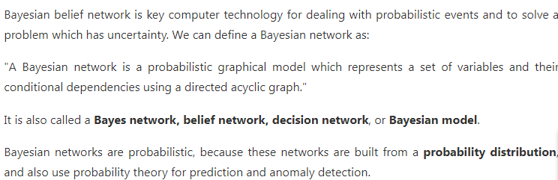
Bayesian Belief Network in artificial intelligence

Slide 34
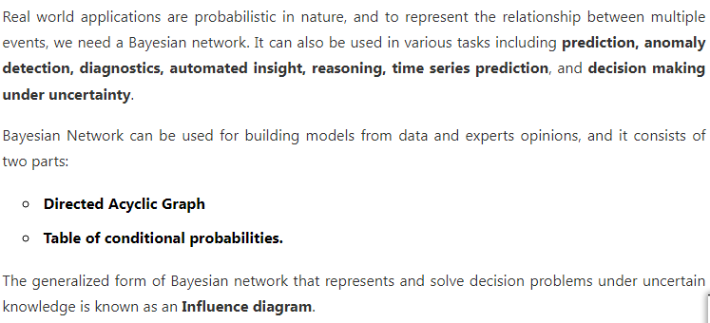

Slide 35
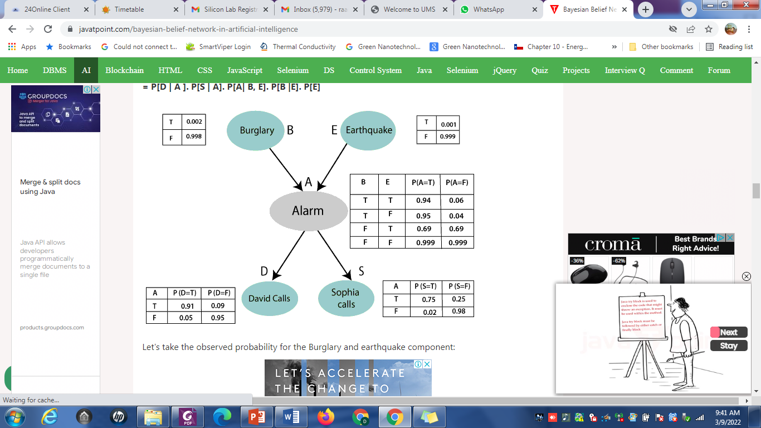
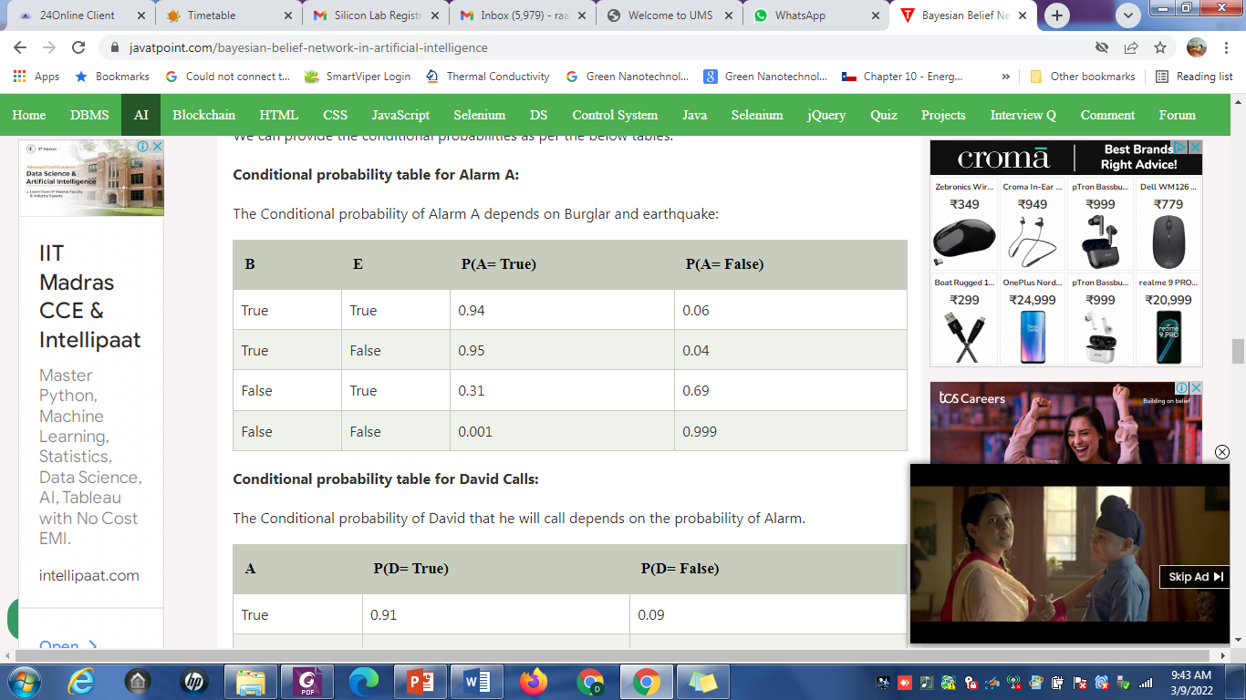

Slide 36
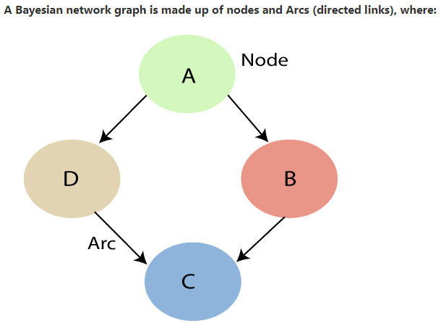

Slide 37
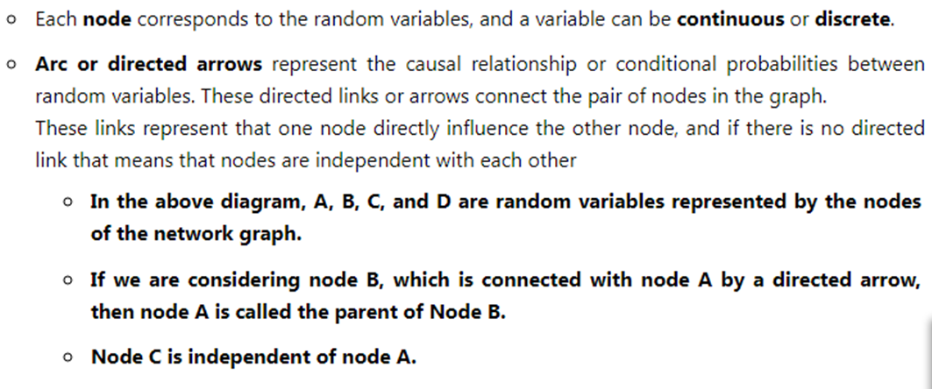

Slide 38
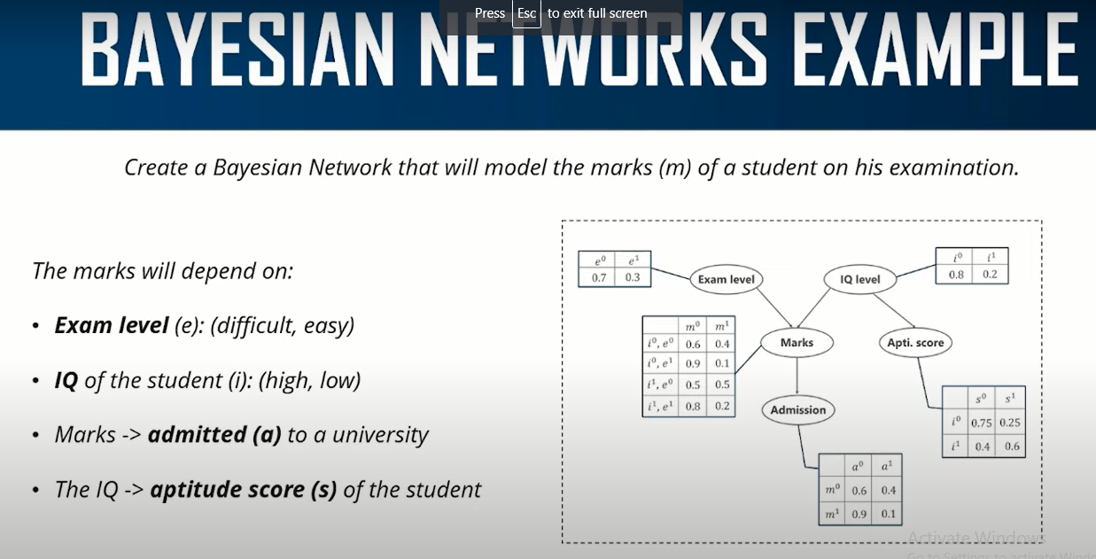

Slide 39
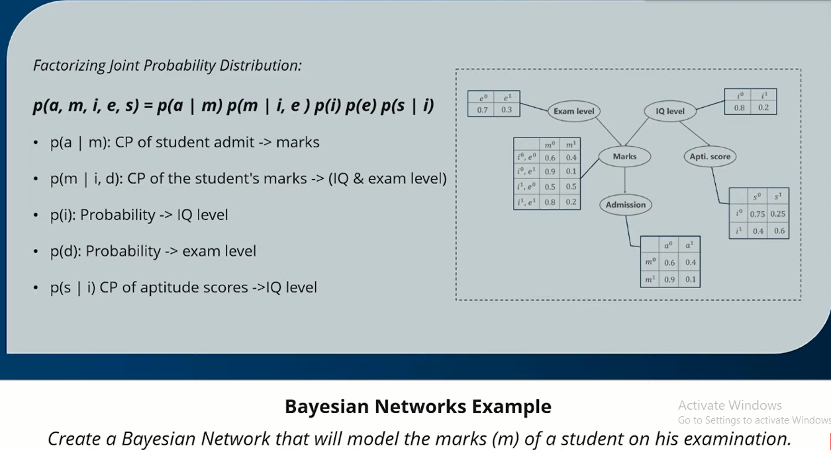

Slide 40
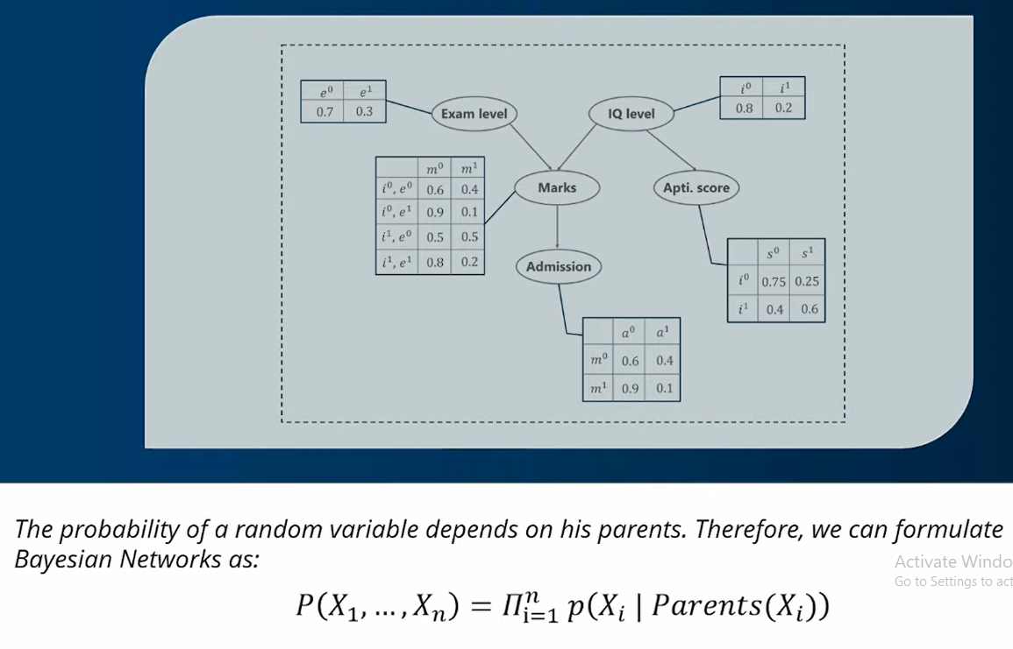

Slide 41
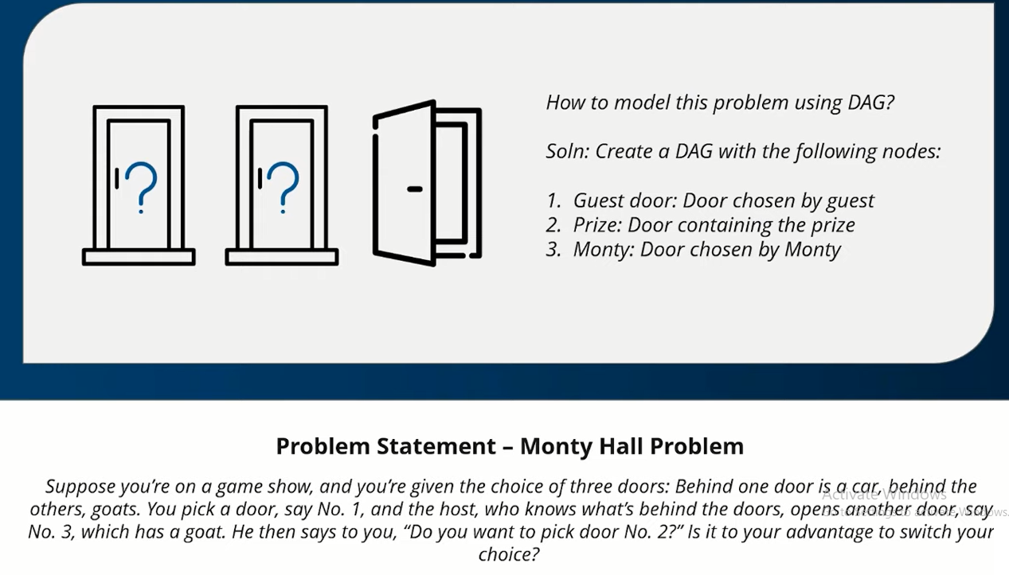

Slide 42
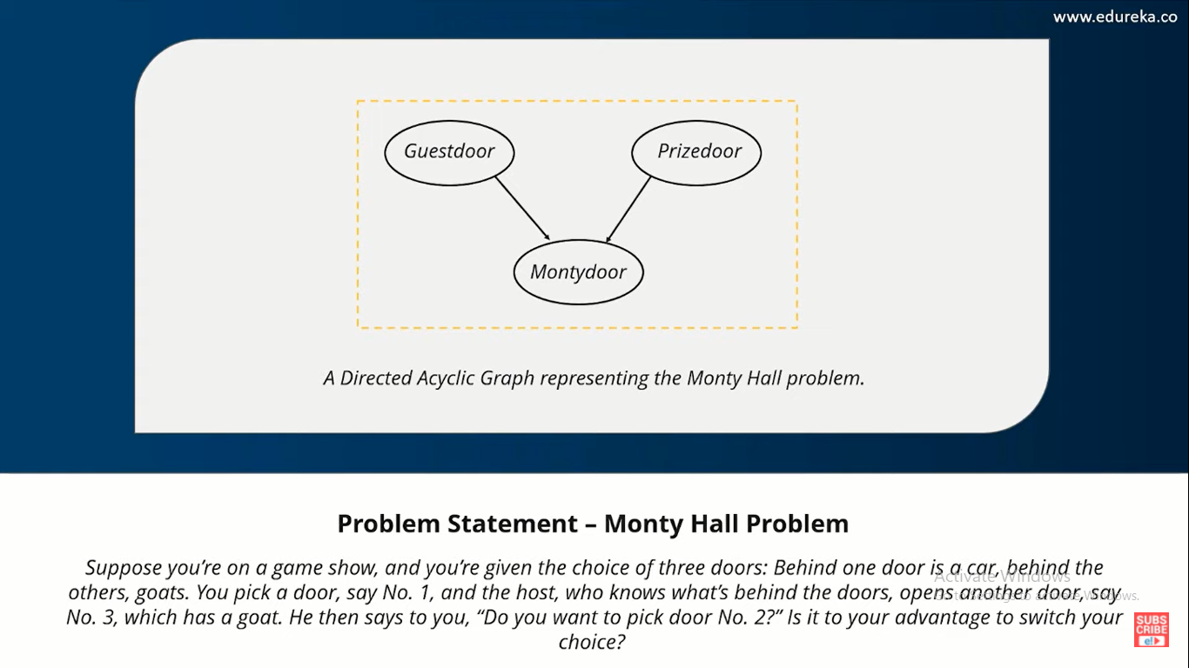

Slide 43
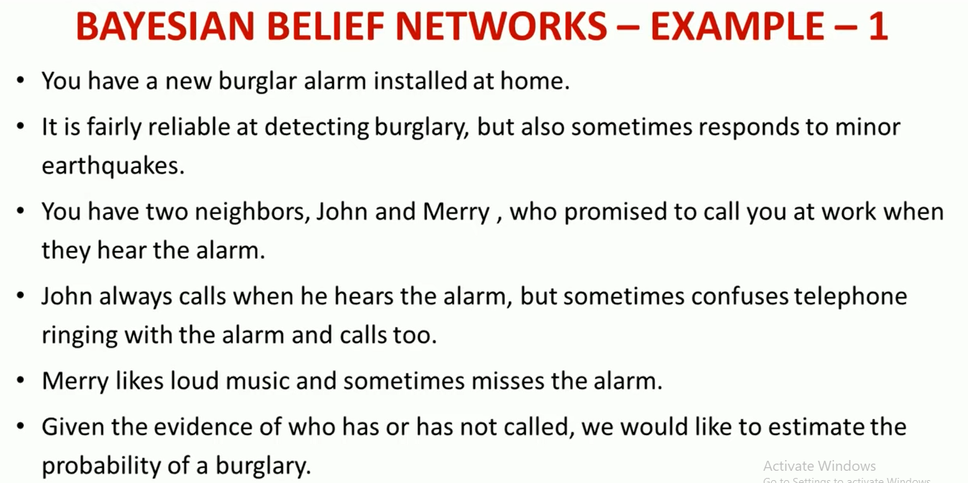

Slide 44
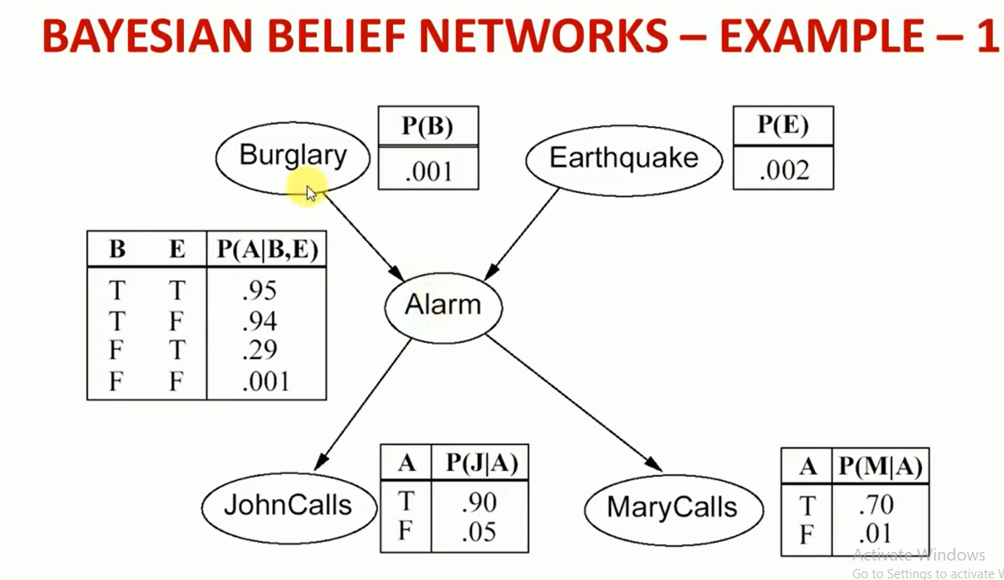

Slide 45
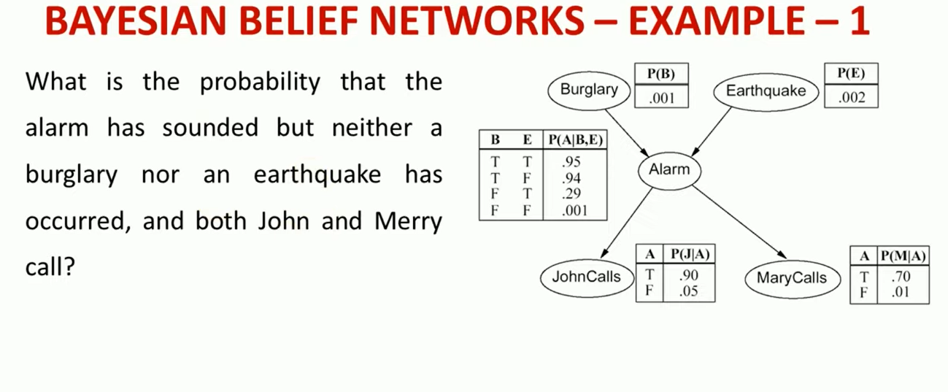

Slide 46
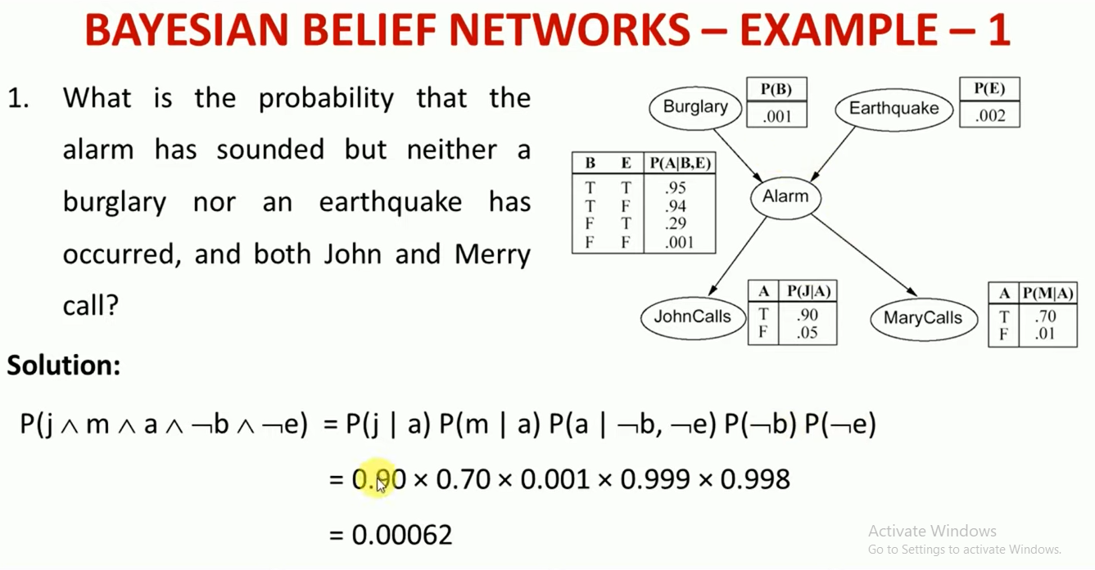

Slide 47
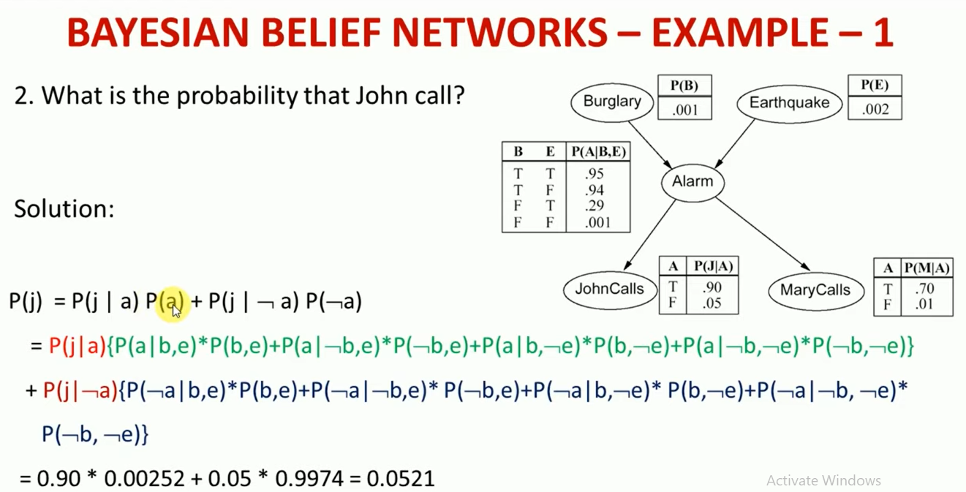

Slide 48
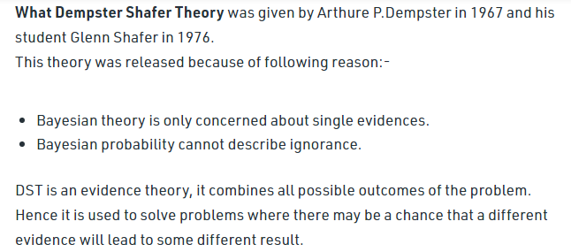
Dempster – Shafer Theory (DST)

Slide 49
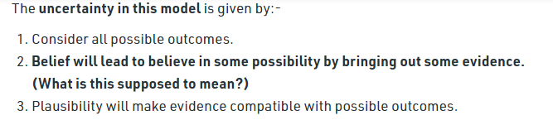

Slide 50
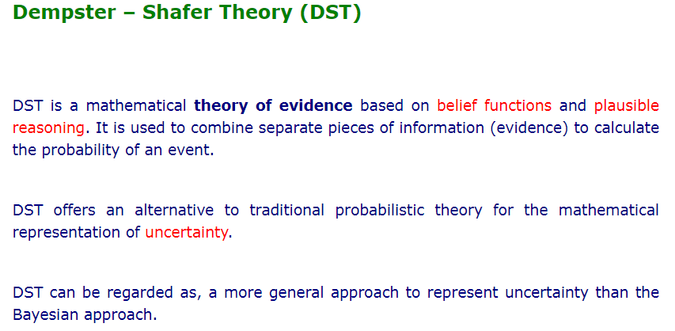

Slide 51
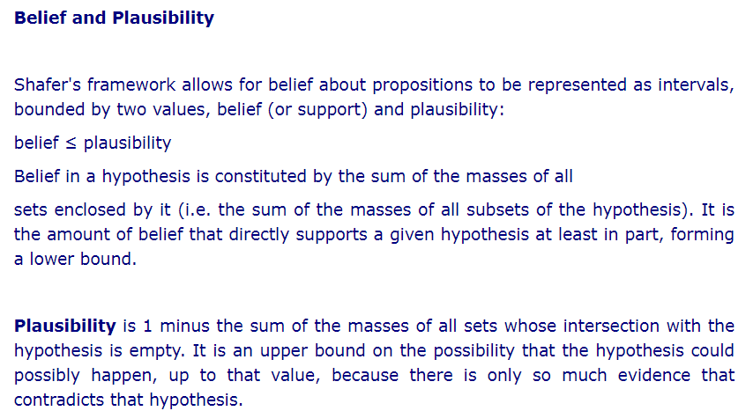

Slide 52
Dempster – Shafer Theory (DST) is a combination of
Belief and plausibility
Belief and mass
Plausibility and mass
Belief and intermediate

Slide 53


Slide 54


Slide 55


Slide 56


Slide 57


Slide 58


Slide 59


Slide 60


Slide 61
The quality of reasoning is
Belief
Plausibility
Mass
All the above

